Slide 1
Predicting Energy Consumption of Residential Buildings
Brad Painting
Mentor: Dhiraj Khanna

Slide 2

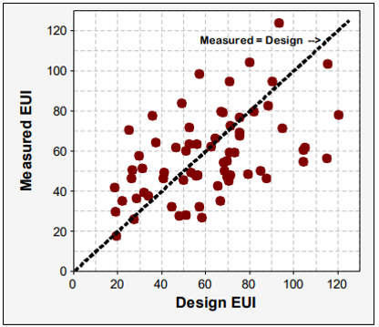
The Problem
Building energy models requires lots of time and industry experience.
A study by NBI found that half of buildings deviated from models by at least 25%.
Figure from New Buildings Institute: Energy Performance of LEED for New Construction Buildings, Final Report Mar. 4, 2008
https://www.solaripedia.com/files/658.pdf
Image Credit: Vectortoons

Slide 3
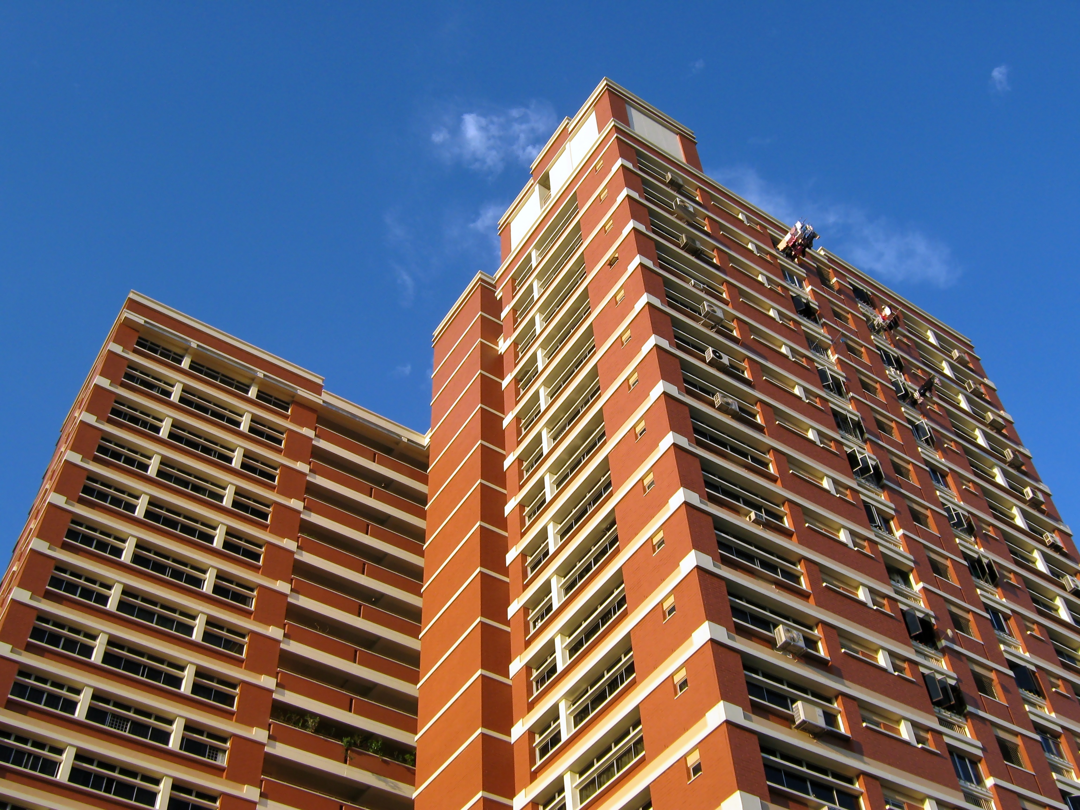
Who and what does the problem affect?
Prospective homebuyers
Public housing authorities
Policies on greenhouse gas reduction
Public Housing Authorities must estimate utility costs to set appropriate rent
Image credit: yeowatzup

Slide 4
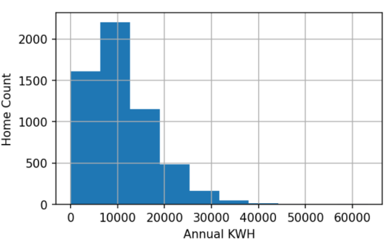
Exploring the Data
Survey of residences across the U.S. by EIA
5,686 rows (buildings)
758 columns
Categorical, ordinal, and numeric data types
Start by looking at outcome variable

Slide 5
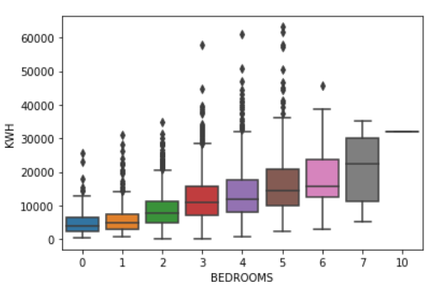
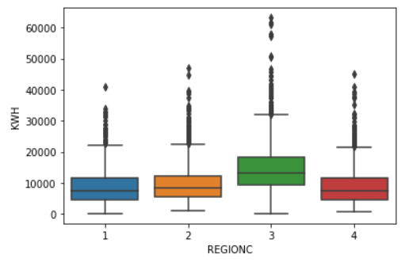
Exploratory Data Analysis (cont.)
The raw dataset has too many variables to explore completely, but the ones of expected importance can still be interrogated. I used boxplots.

Slide 6
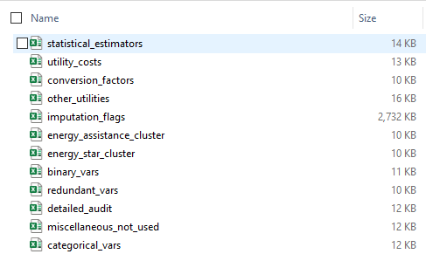
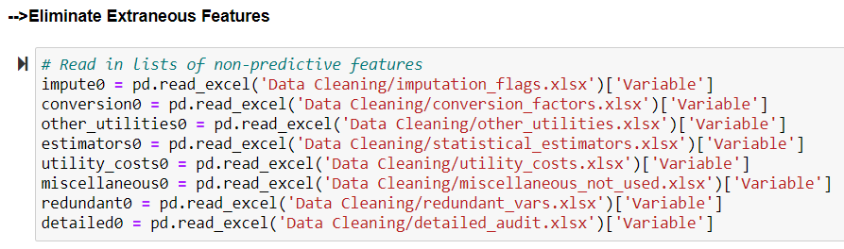
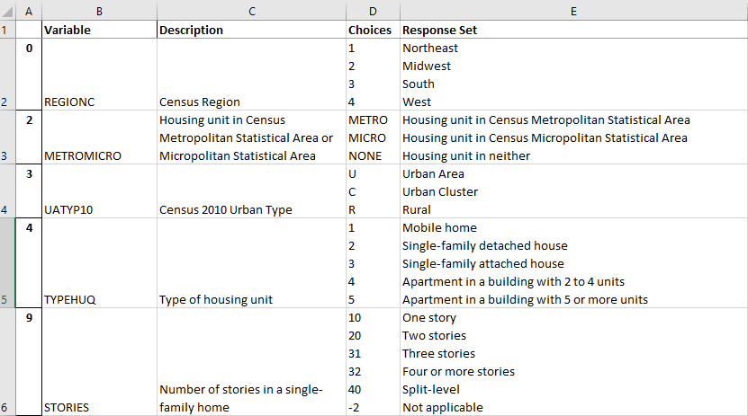
Data Wrangling
Manually Review Response Codebook for:
Numeric variables that are actually categorical
Features definitely not relevant
Create Excel lists of variables to import for removal or recoding

Slide 7
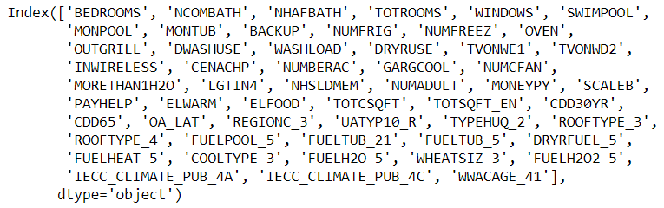
Feature Selection
Lasso Regression to further reduce dimensionality
Alpha parameter = 2 to balance precision vs. simplicity
Higher alpha = less features
Lower alpha = more features
307 features → 54 features

Slide 8
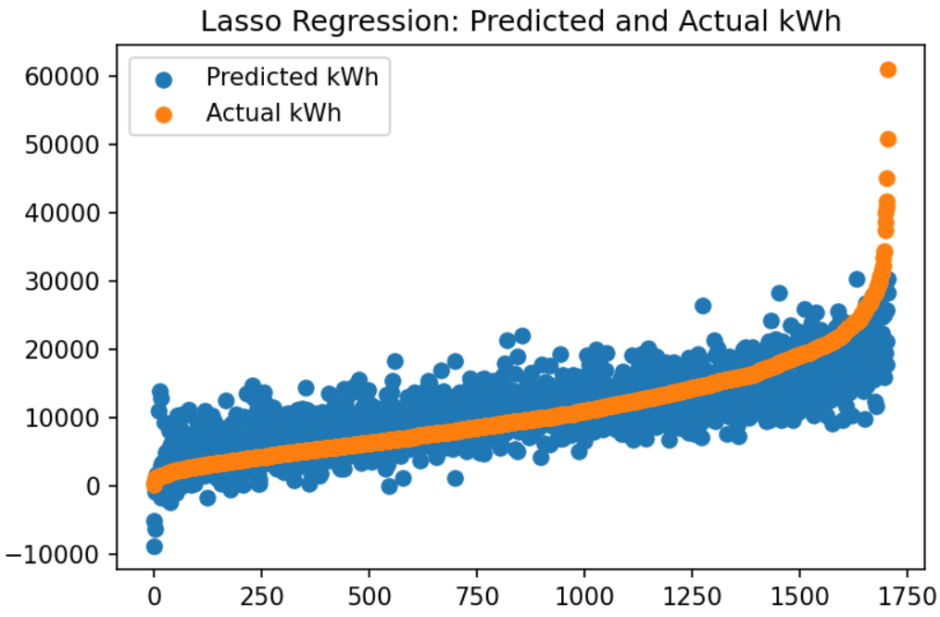
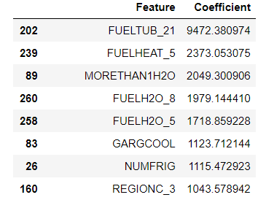

Modeling
Lasso model coefficients ranked by importance
Lasso achieved best CV score

Slide 9
Conclusions
All models provided similar predictive power, but Lasso is preferred
Using 5-fold cross validation, Lasso RSME = 0.62
Features most predictive of high kWh consumption:
Owning a hot tub (specifically, heated by “some other fuel” per survey)
Having electric space heating
Having multiple water heaters
Alpha=2 parameter for Lasso provided adequate feature reduction, but could be explored further

Slide 10
Suggestions for Further Work
Develop confidence intervals on electricity prediction
Compare the RMSE of the ML model against a study of energy modeling error encountered with engineering-based heat transfer models
Perform more parameter tuning (e.g. grid or random search)
Perform EDA on features selected by LASSO regression
Develop ML models for other utilities

